Slide 1
DATABASE DESIGN & IMPLEMENTATION
CarDiag
AI-Powered Car Fault Diagnosis System
Task 6 · Internet & Mobile Programming
Group 12 · Faculty of Engineering and Technology, University of Buea
Course Lecturer: Dr. Nkemeni Valerie

Slide 2
OVERVIEW
What This Presentation Covers
1
Introduction
2
Data Elements
The role of the database in CarDiag
Every field the system stores
3
Conceptual Design
4
ER Diagram
Entities, relationships and rules
Visual structure of the data
5
Database Implementation
6
Backend Implementation
PostgreSQL and pgvector
Spring Boot layered architecture
7
Connecting to Backend
8
Conclusion
Configuration and data population
Summary of the design

Slide 3
01
Introduction
The database as the foundation of the CarDiag system

Slide 4
SECTION 1
Introduction
The database is the foundation of CarDiag.
It stores the fault knowledge base, user accounts, diagnostic records, embedding vectors, and cached video tutorials.
CarDiag matches dashboard images, engine sounds, and text descriptions against the fault catalogue and returns an explanation, urgency level, repair tips, and video tutorials.
6,152
OBD-II fault codes stored
1024
dimensions per embedding vector
5
core entities in the schema
3
input types: image, audio, text

Slide 5
02
Data Elements
The individual pieces of information the system stores

Slide 6
SECTION 2 · DATA ELEMENTS
User & Fault Embedding Data
User
Fault Embedding
Element | Type
id | Integer
firstName | String
lastName | String
email | String
password | String
role | String
createdAt | Timestamp
Element | Type
id | Integer
fault_id | String (FK)
modality | Enum
sourceText | Text
embedding | Vector(1024)
modelVersion | String
createdAt | Timestamp

Slide 7
SECTION 2 · DATA ELEMENTS
Fault Data — The Core Knowledge Base
Data Element | Description | Data Type
id | OBD-II fault code (e.g. B1200, P0301) | String
name | Name of the fault | String
category | Fault category (Engine, Brakes, etc.) | Enum
description | Full description of the fault | Text
symptoms | List of observable symptoms | Text (JSON)
causes | List of probable causes | Text (JSON)
repairTips | List of recommended repair actions | Text (JSON)
urgency | Urgency level (CRITICAL to LOW) | Enum
warningLight | Associated dashboard warning light | Enum
createdAt | Record creation date and time | Timestamp

Slide 8
SECTION 2 · DATA ELEMENTS
Diagnosis & Video Data
Diagnosis
Video
Element | Type
id | Integer
user_id | Integer (FK)
inputType | Enum
imageDescription | Text
audioTranscription | Text
userText | Text
matched_fault_id | String (FK)
confidence | Double
llmReport | Text
Element | Type
id | Integer
fault_id | String (FK)
videoId | String
title | Text
channelName | Text
thumbnailUrl | Text
videoUrl | Text
cachedAt | Timestamp
expiresAt | Timestamp

Slide 9
03
Conceptual Design
Entities, relationships, and business rules

Slide 10
SECTION 3 · CONCEPTUAL DESIGN
The Five Core Entities
1
2
3
User
Fault
FaultEmbedding
A registered user of the application
A known vehicle fault from the OBD-II catalogue
The vector form of a fault for AI search
4
5
Diagnosis
Video
A single diagnosis performed by a user
Cached video tutorials linked to a fault

Slide 11
SECTION 3 · CONCEPTUAL DESIGN
Relationships & Business Rules
Relationships
Business Rules
Relationship | Type
User — Diagnosis | One-to-Many
Fault — FaultEmbedding | One-to-One
Fault — Diagnosis | One-to-Many
Fault — Video | One-to-Many
Every fault has a unique fault code.
A diagnosis may exist without a user (guest mode).
Each fault has exactly one embedding.
Cached videos expire after a set period.
Deleting a fault removes its embedding and videos.

Slide 12
04
Entity Relationship Diagram
The visual structure of the data

Slide 13
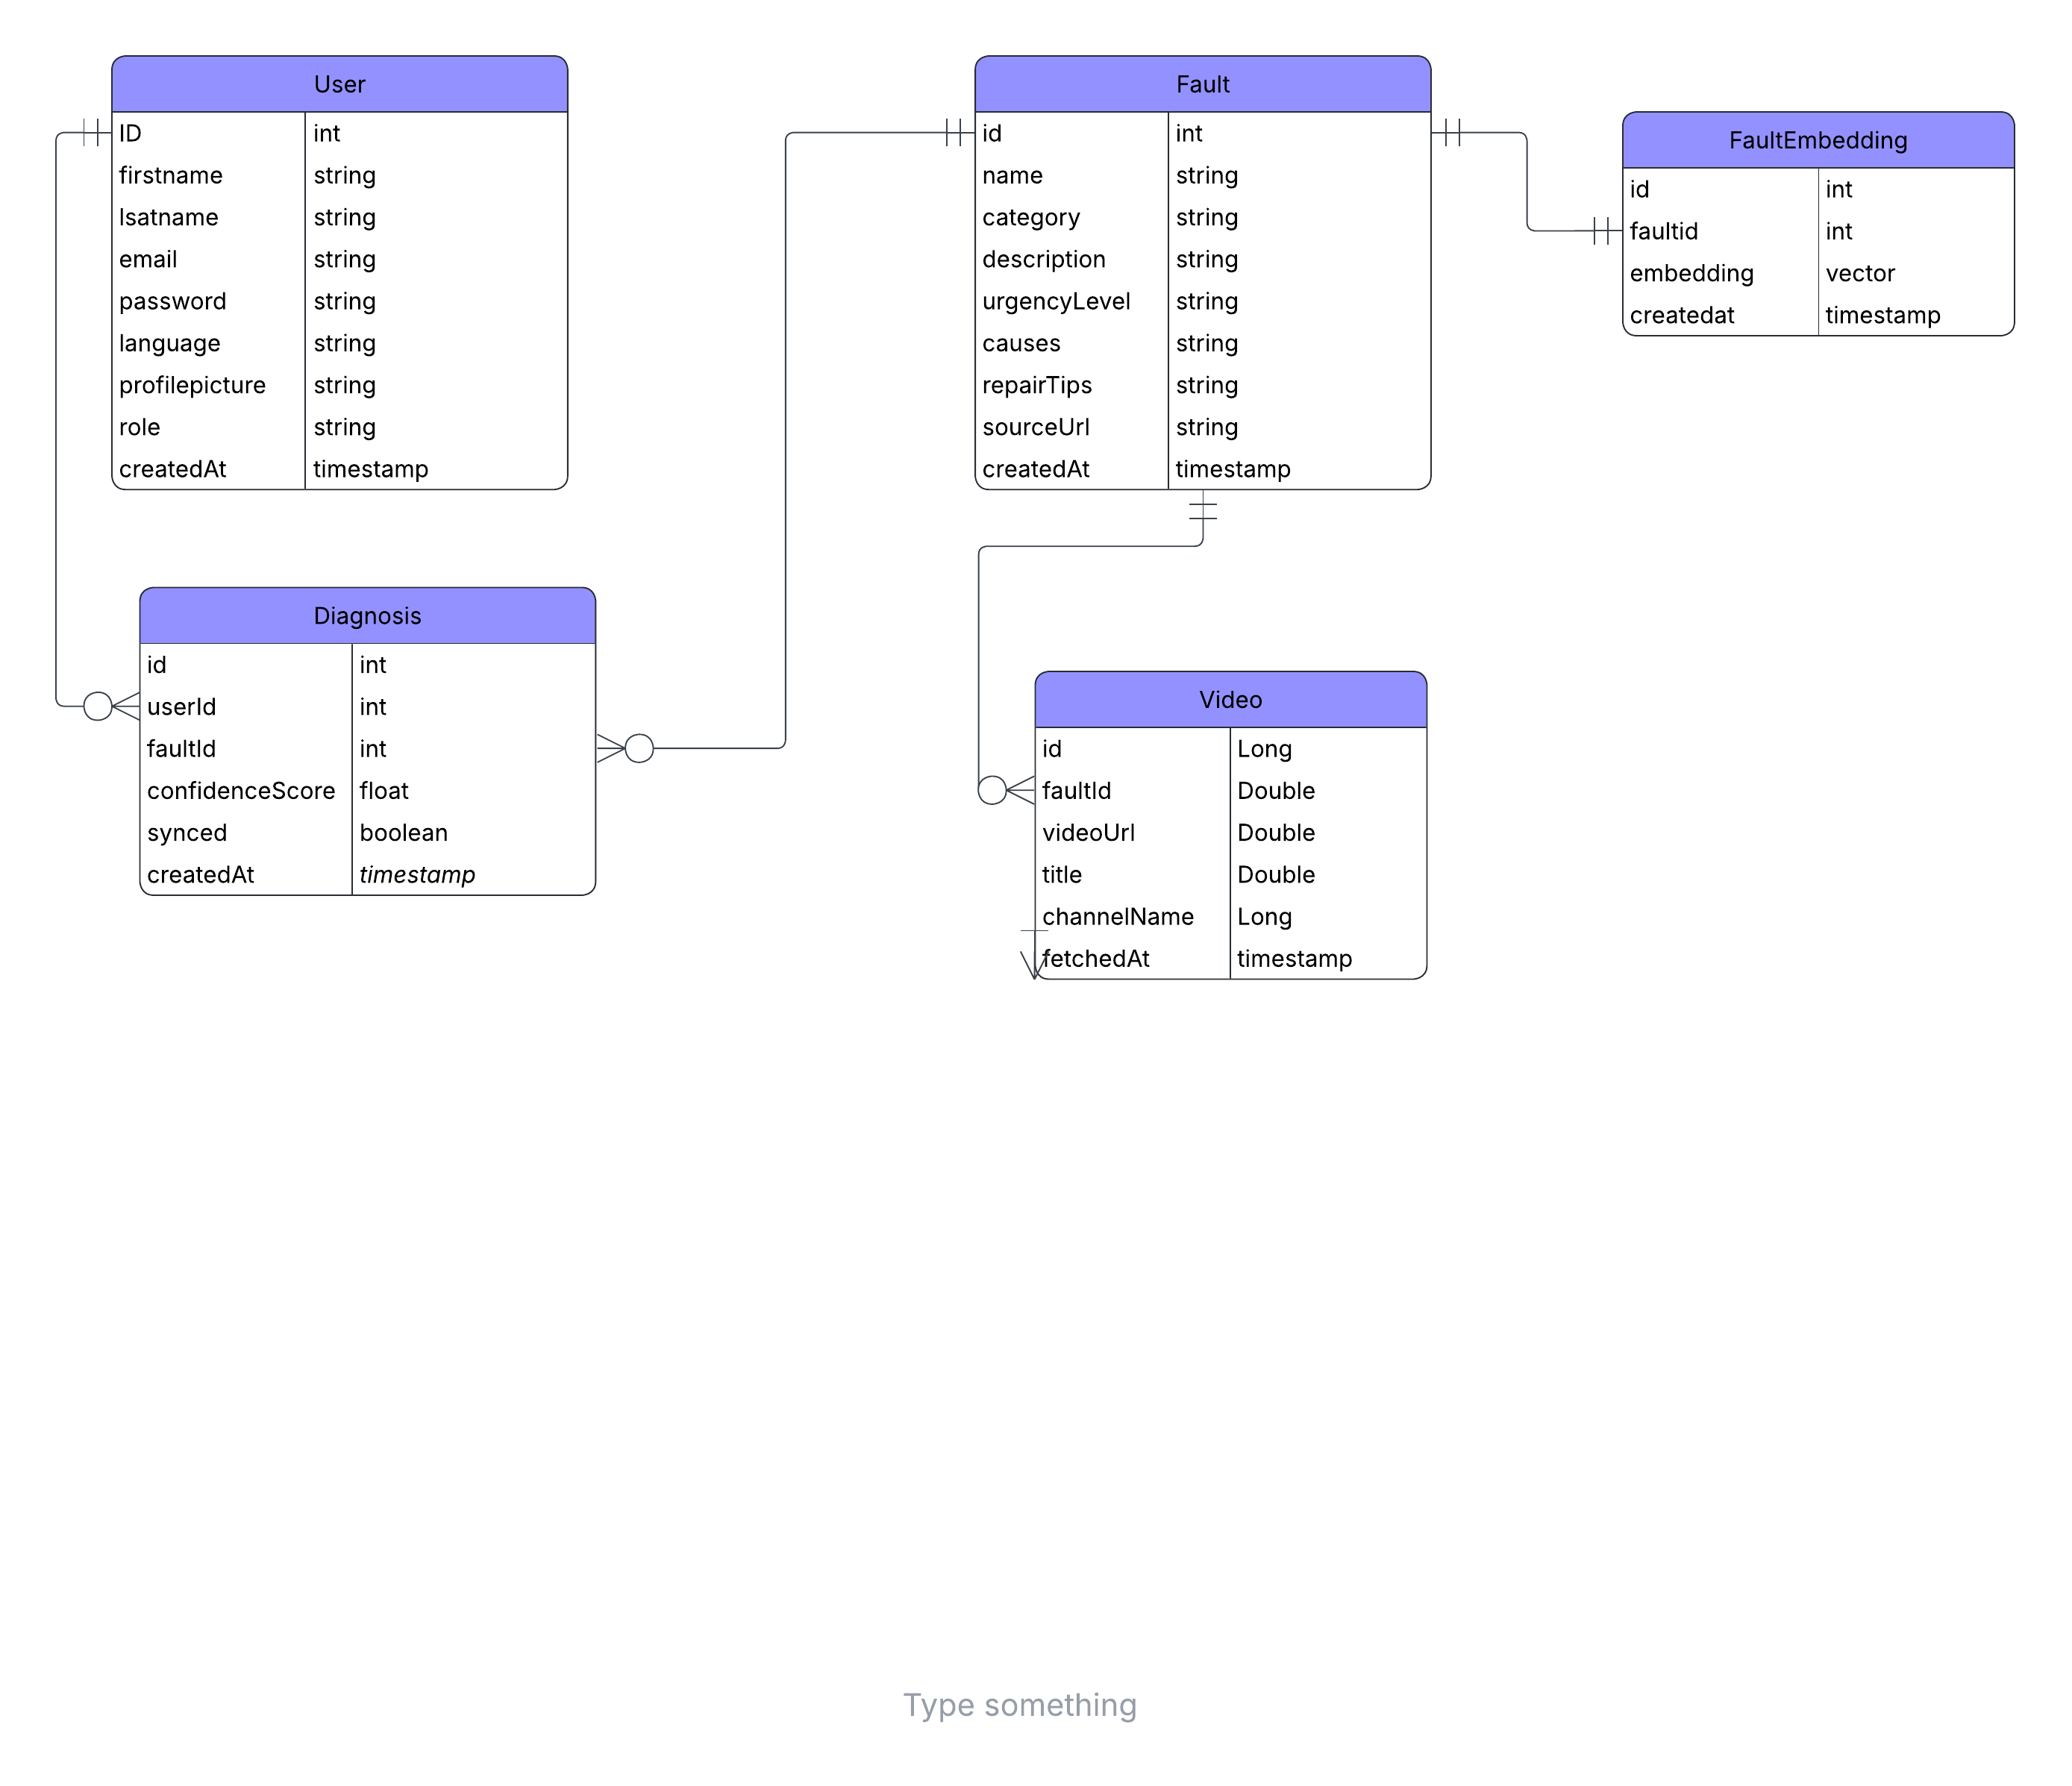
SECTION 4 · ER DIAGRAM

Slide 14
05
Database Implementation
PostgreSQL with the pgvector extension

Slide 15
SECTION 5 · DATABASE IMPLEMENTATION
PostgreSQL & pgvector
DBMS
PostgreSQL
Embedding table & vector index
Reliable, open-source, supports vector search
CREATE EXTENSION IF NOT EXISTS vector;
CREATE TABLE fault_embeddings (
id BIGSERIAL PRIMARY KEY,
fault_id VARCHAR(20) UNIQUE,
embedding vector(1024) NOT NULL,
created_at TIMESTAMP DEFAULT NOW()
);
CREATE INDEX idx_cosine ON fault_embeddings
USING ivfflat (embedding vector_cosine_ops);
Extension
pgvector
Stores and searches embedding vectors
Hosting
Docker container
Consistent local setup

Slide 16
06
Backend Implementation
Spring Boot with a clean layered architecture

Slide 17
SECTION 6 · BACKEND
Layered Architecture & Diagnosis Pipeline
Layered Architecture
The Diagnosis Pipeline
Controller
Receives HTTP requests, returns responses
1
Input is described in text by an AI model
2
Description is converted into an embedding
Service
Business logic & the diagnosis pipeline
3
Vector is matched against stored faults
Repository
Reads and writes to the database
4
Confident match retrieves full fault details
5
AI report generated, video tutorials fetched
Entity
Java classes mapped to database tables
6
Diagnosis saved to database and returned

Slide 18
07
Connecting to the Backend
Configuration, ORM, and data population

Slide 19
SECTION 7 · CONNECTION
Configuration & Data Population
How the Connection Works
application.properties
spring.datasource.url=
jdbc:postgresql://localhost:5432/cardiag
spring.datasource.username=postgres
spring.datasource.password=********
spring.jpa.hibernate.ddl-auto=update
On startup the backend establishes a connection pool, verifies the entity classes match the tables, then translates every repository call into a database query.
Vector operations use native SQL: float arrays are converted to pgvector format, and cosine distance finds the most similar faults.
Data Population — two one-time pipelines
1 Read 6,152 OBD-II fault codes from a structured file into the faults table. 2 Generate each fault's embedding vector and store it in the fault_embeddings table.

Slide 20
CONCLUSION
A Solid, Scalable Foundation
Data elements were identified from the system requirements, a conceptual design defined the entities and their relationships, and an ER diagram captured the structure.
The database was implemented in PostgreSQL with pgvector for AI similarity search, and the Spring Boot backend follows a clean layered architecture connected through configuration and ORM.
6,152
1024-D
5
100%
faults
vectors
entities
functional

